Slide 1
Lesson Plan: Preparing for an interview with a whole class or group
Men’s Rugby World Cup and Women’s WXV interview competition
Lesson adapted from resources at:
Resources and prize support from:

Slide 2
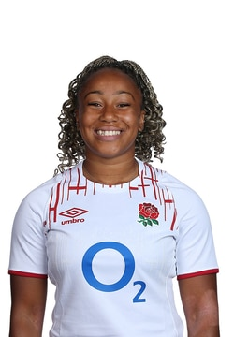
Men’s Rugby World Cup and Women’s WXV interview competition
Plan an interview for your rugby hero about their Rugby World Cup experiences.
Winners to interview Sadia Kabeya of England and Loughborough Lightning
(application details on the last slide)
Resources and prize support from:

Slide 3
What do you notice about the questions in this interview with England Men’s World Cup player Maro Itoje?
How are the questions phrased so that Maro is encouraged to give detailed answers?
How are the questions asked in an entertaining manner?
It helps that both know each other well. How could you make the person you interview feel relaxed?

Slide 4
How can you prepare to interview a rugby star?
Think about
Think about what it would be like to be a famous rugby player. Wouldn’t it be fascinating if we could hear them from that time speaking about their experiences as a child when they started playing the game and how they feel now they have played (or are about to play) in a World Cup.
Listen
Listen and watch recordings of sports stars speaking about their live and what it is like to be a sports man or woman at the top of their game. What makes the interview interesting? How do the questions make it interesting?
Discuss
Discuss proposed a class/group interview. (The subject of our example is ‘Journey from a child to a World Cup star’ )

Slide 5
Helping people talk (Exercise 1)
In pairs, practise asking each other to talk for about 3 minutes about memories of first attending school.
Report back on what you learnt. (If recording equipment is available, record one of these short interviews and play part of it back)
Things to think about:
Don’t ask too many questions, which may prevent the person you’re recording from telling their story in their own way.
Use general prompts like “Tell me about your first weeks at school”. Avoid questions that get one word answers.

Slide 6
Helping people talk (Exercise 2)
You (teacher) choose a personal memory that you are happy to talk about e.g. past holiday, family wedding, own school experience.
Give some basic information about your memory – with photos if available.
Warn class/group that you will answer with one word if you can, so they must use open-ended questions e.g. “Describe your family” rather than “How many people are in your family?”
Tell them to think about the order they ask the questions in. What do they need to know first? How can they get you to ‘set the scene’ – before asking you for greater detail or how you felt about things.

Slide 7
Preparation for actual interview 1
Give basic information about interviewee: date of birth; where brought up; what parents did; brothers and sisters; where they started to play rugby, who they play for now and what position they play. (This can be written down and recorded at start of interview, to save beginning with short questions and answers.)
Show photos if available (some are provided later in this slide show as an example).
Class discussion: what do we want to find out? Many young people think of an interview as being like a general celebrity questionnaire –“What’s your favourite film?”; “Who do you most admire?” These might be suitable questions for later in the interview but explain that it’s confusing to jump about from subject to subject and better to go through a life-story in order.
As they suggest prompts, put them on a whiteboard or flip chart in what you think is a suitable order, until you have an outline of the whole recording. They could carry out some research to find an interesting point to ask about.

Slide 8
Preparation for actual interview 2
Here’s an example of a list of prompts:
Family; place where brought up; school; out-of-school activities
First memories of rugby
Can you describe what made you love the game of rugby?
People you remember
How did you progress?
How did you change as you got older?
Any other special memories ?
Looking back, what do you remember best?
What would you at 12 years old asked you now?
What would you tell the 12 year old you?

Slide 9
Preparation for actual interview 3
Explain that this list will help them with the interview, but the real art of interviewing is listening to what someone says and asking something that follows on from it.
If the actual interview is recorded straightaway, they can look at the prompts on the board. If the interview will take place later, get them to write their own brief prompts for future use.
Remind them that if they can’t think of a question they can always try “What else do you remember?”

Slide 10
The Actual Interview
Try using a guest or adult to help act out the interview as the person they have planned for
Set up interview space and test your recorder.
Decide who asks the questions and in what order.
Say it’s important not to put hands up or look as if you’d like to interrupt, while the interviewee is speaking, as you can’t know what to ask until you’ve heard what they have to say!
Collect your interviewee and explain what will happen.
Record the interview.
Towards the end, make sure someone asks a ‘wrapping-up’ question (“Looking back….)
If time, ask interviewee for any memories not covered.
Turn off the recorder and check the recording.
The actual interview!

Slide 11
Possible follow up activities
Depending on age of class/group, you could get them to:
Write thank-you letters
Write a short account of what they’ve heard or draw an illustration.
Write an imaginary story or drama with your star as the main character.
If you have a good recording, make ‘production decisions’ about the best bits. Consider transcribing or editing these memories.
Share what they’ve learnt with another class.
Compare the oral testimony with written sources/ photos. What insights have they gained from the interview?

Slide 12
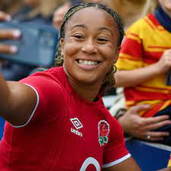
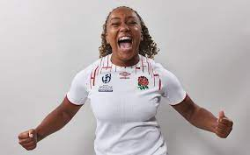
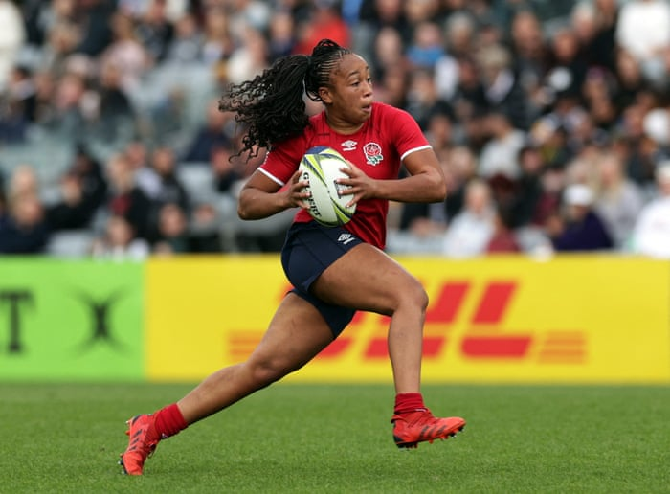
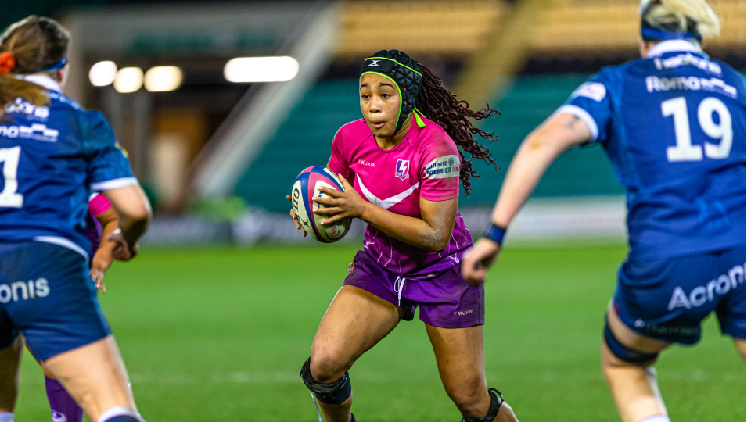
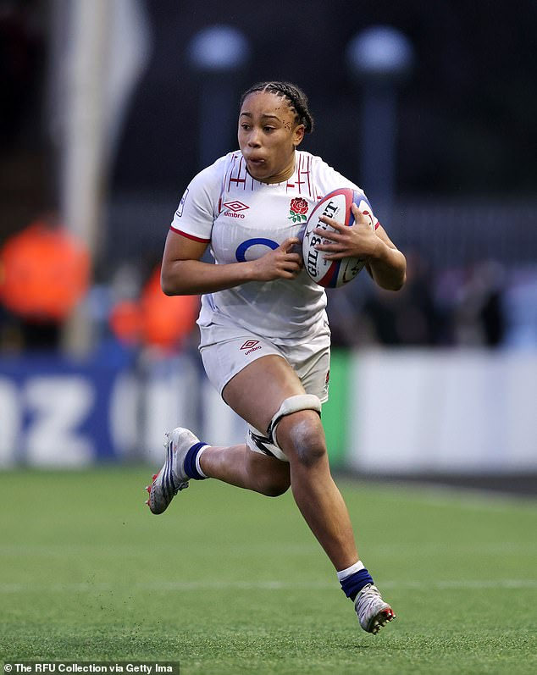
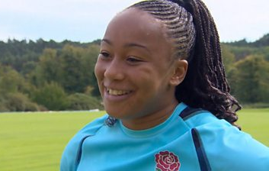
Sadia Kabeya - images

Slide 13
Sadia Kabeya – online information
Sadia’s England rugby profile: https://www.englandrugby.com/england/senior-women/squad/sadia-kabeya
A newspaper interview with Saia Kabeya https://www.theguardian.com/sport/2023/mar/24/sadia-kabeya-i-wasnt-one-who-set-their-sights-on-playing-for-england
Sadia talks on the BBC website about how she looks after her hair https://www.bbc.co.uk/sport/rugby-union/65240196
Videos
An interview with Sadia when she first became a professional rugby player at Richmond RFC: https://www.youtube.com/watch?v=cX23inDZ0sY
Sadia interviewed before the England v France match in 2023 https://www.youtube.com/watch?v=wiMyftCPIjA

Slide 14
Men’s Rugby World Cup and Women’s WXV interview competition- how to enter
Plan an interview for your rugby hero about their Rugby World Cup experiences.
Winners to interview Sadia Kabeya of England and Loughborough Lightning in November 2023.
Competition entries can be in the form of a script or video.
Send the competition entries to:
Deadline for applications: Friday 27th October
Information related to entrants to the competition will not be shared without written consent from the entrant, their parents and their school.
The winning interviewers will be informed by Monday 6th November

