Slide 1
Notes:
Sitting

Slide 2
NLD Youth Council
Notes:
Intros

Slide 3
Who Are We?
What Do We Do?
Why Do We Do It?
We are comprised of young people across the 3 counties, representing a range of clubs, some of whom are here today.
Our aim is to bring a younger perspective to the governance of rugby, to make it more accessible to more people.
The future of rugby is in the young people involved in it. Their contribution has to be heard.
Notes:
Spalding, Ashbourne, etc.

Slide 4
Who Are We?
What Do We Do?
Why Do We Do It?
We are comprised of young people across the 3 counties, representing a range of clubs, some of whom are here today.
Our aim is to bring a younger perspective to the governance of rugby, to make it more accessible to more people.
The future of rugby is in the young people involved in it. Their contribution must be heard.
Notes:
Rugby is not solely playing, get younger people involved in governance.

Slide 5
Who Are We?
What Do We Do?
Why Do We Do It?
We are comprised of young people across the 3 counties, representing a range of clubs, some of whom are here today.
Our aim is to bring a younger perspective to the governance of rugby, to make it more accessible to more people.
The future of rugby is in the young people involved in it. Their contribution must be heard.
Notes:
There is no rugby club without a youth system, more on this later.

Slide 6
Projects
Notes:
With an objective presented to us by the NLD of Recruitment and Retention, we’ve looked at different ways of getting more people playing rugby, as well as helping those currently playing stay interested and continue to play. This has been done primarily through playing events such as ColtsFest and an U12 Festival, however we are now looking at diversifying our strategy.

Slide 7
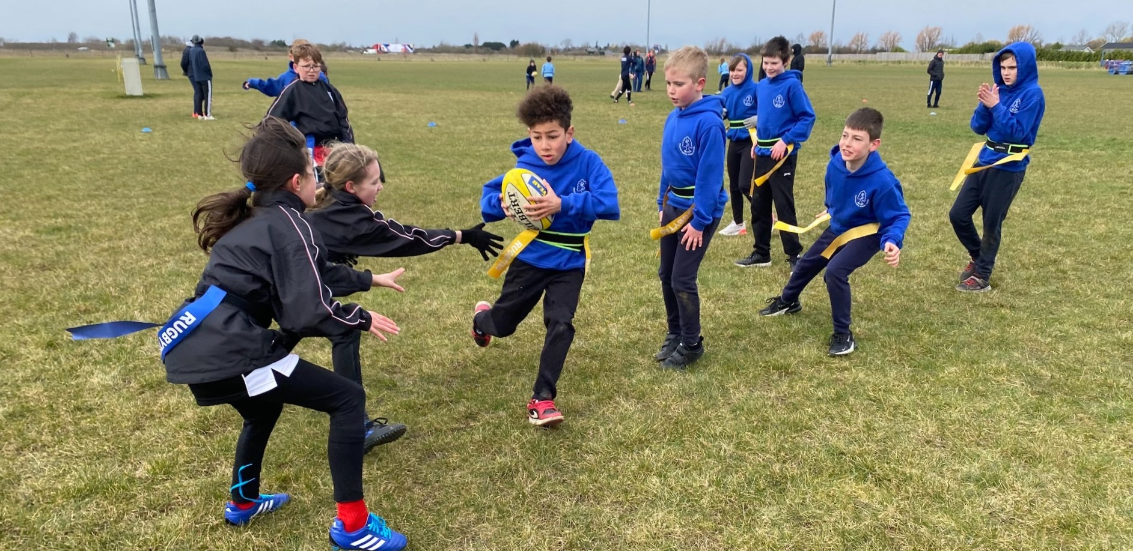
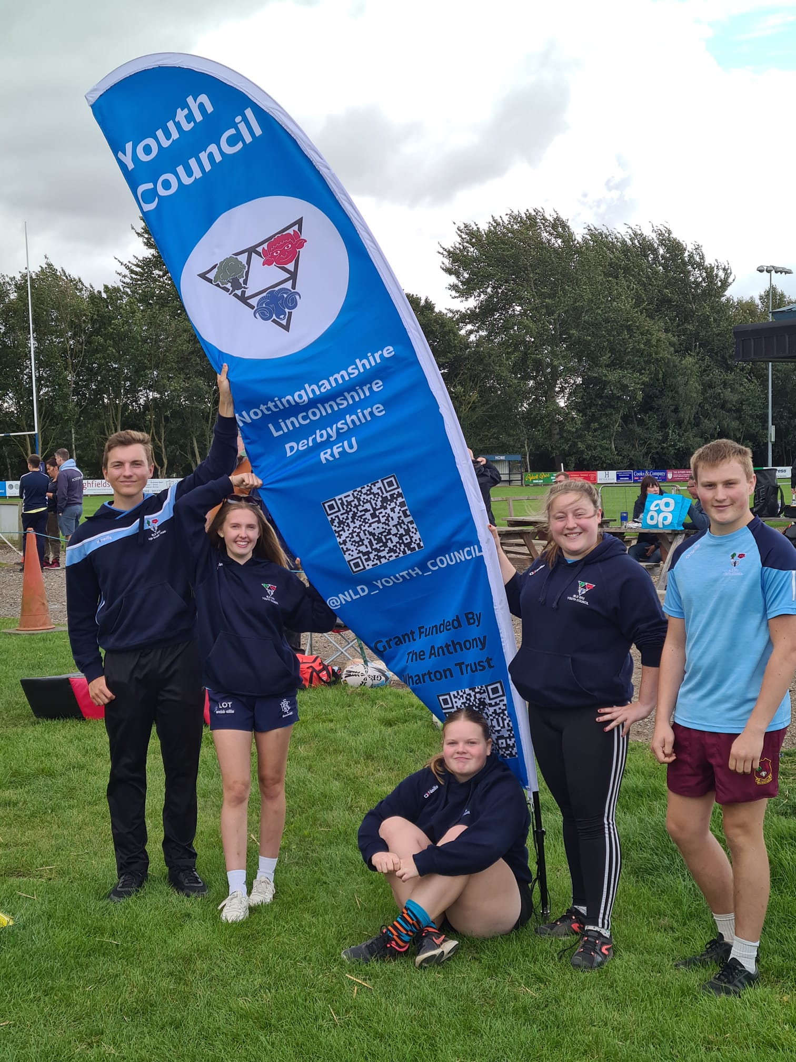
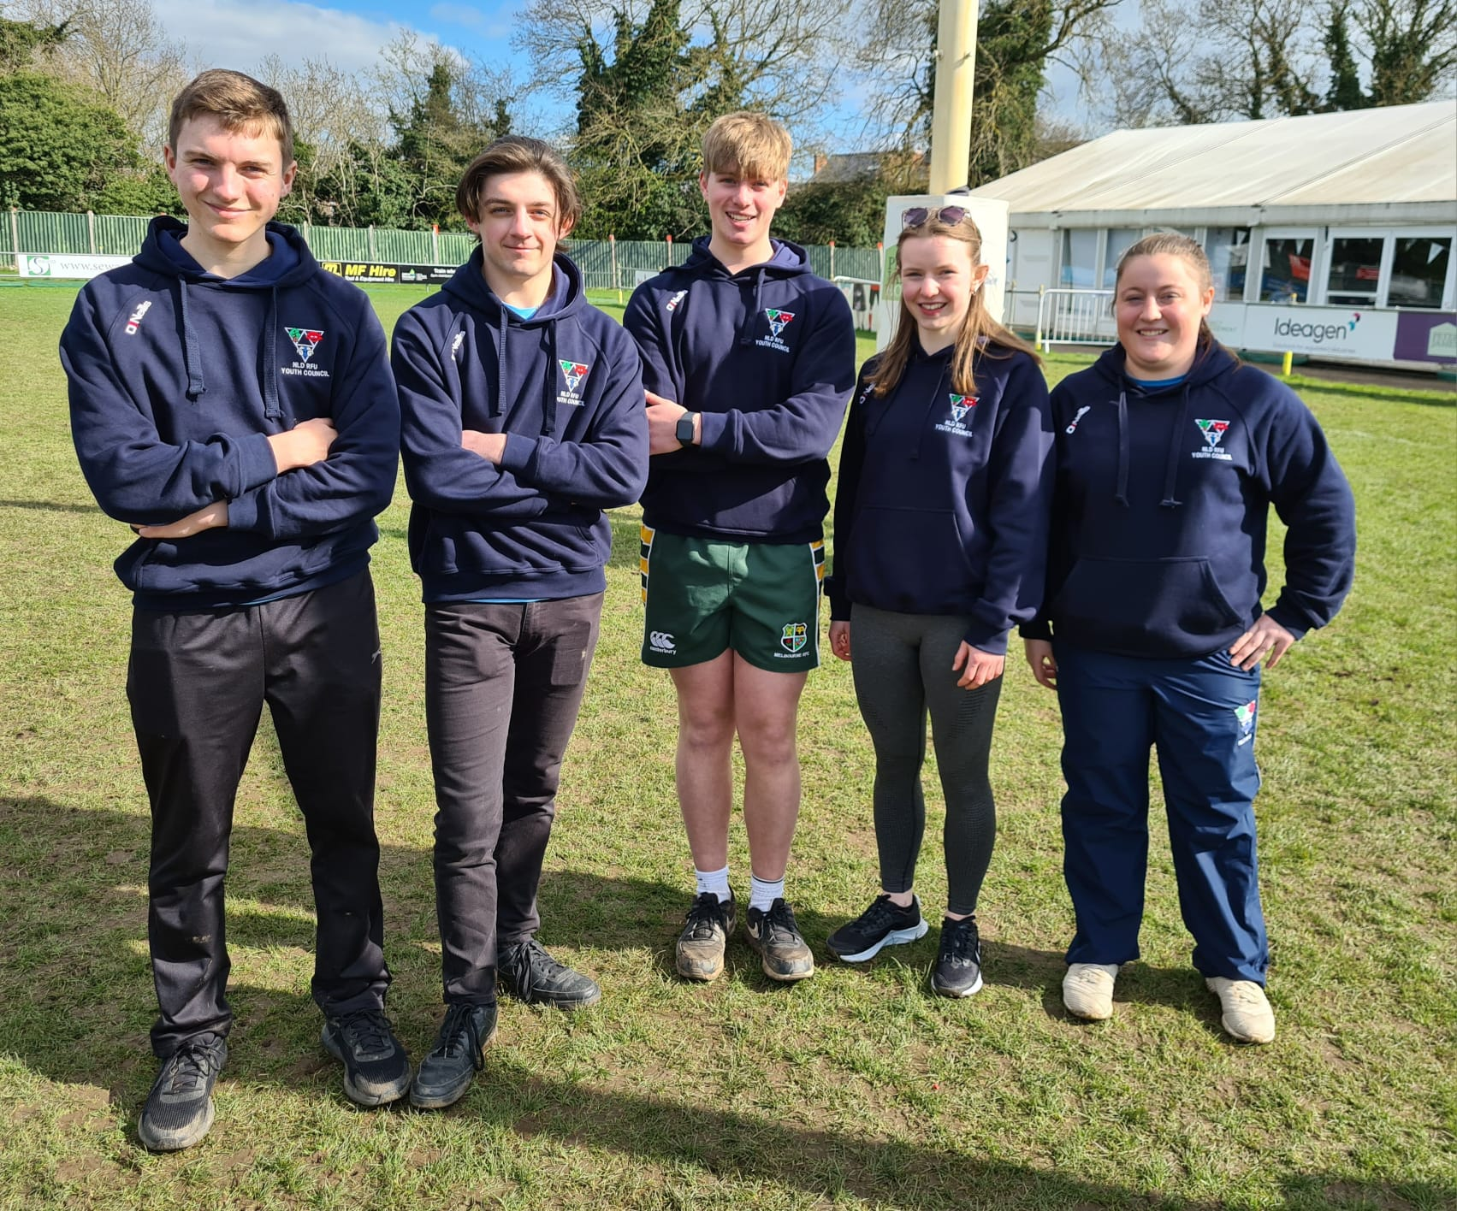
Our past projects
Colts Fest I
Spalding schools tournament
U12 festival
Colts fest II

Slide 8
Before we start our main discussions
…. a task

Slide 9
Where in the UK or the World, were you born?
Can you order yourselves from North to South?

Slide 10
Youth Representatives:
An opportunity to hear from your young players about the challenges facing your clubs.
Different perspectives to those coaching, or parents on the sideline.
Encourages participation in the governance of rugby in your club, from those at younger age groups.
Notes:
Our new strategy is the implementation of Youth Representation in clubs. We’re aware some clubs already have youth representation, but we’d like this to go further within clubs, and wider in the number of clubs doing this. Why?

Slide 11
One-Club Mentality
Notes:
One club mentality essentially suggests that all those involved in the club help all sides of clubs. Youth systems have previously been neglected, from issues such as coach and volunteer availability. Seeing the youth system as an integral part of the club is paramount for the club’s survival. In grassroots rugby, our clubs rely on young players travelling through the youth systems, and eventually becoming senior players, but a lot are lost in the younger age groups. This could be seen in a first team player leading a session for a youth team, or even being present at games, fostering those links between age grades. Off the pitch, one way this can be prevented is through proper, professional discussion with the younger club members, hence our strategy of youth representatives. We would like to see a couple of youth volunteers involved in discussions at AGMs and other senior governance meetings, telling you what their teammates are and aren’t enjoying about the rugby they are playing.

Slide 12
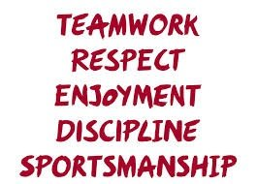
Youth Representatives:
29th Jan 2024 at Ashfield RUFC
Over 10 youth systems represented
Attempted to find out the issues facing youth rugby from those who interact with it most
Notes:
Alongside participation within clubs, we would also like to engage with these youth reps. We held our first forum in Ashfield, and with many clubs represented. We had male and female players, a range of ages, and not all played – some coached and refereed, but were friends with players of their age in their club. This image shows the results of our discussion of what they felt was important to them about rugby. Some commented on the lack of fixtures, and how not all games were competitive, an issue the NLD and other CBs have faced for a while, but the overwhelming message was they enjoyed the spirit of rugby, embodied in the TREDS values. We think this is the most powerful message. Engaging your youth players doesn’t have to be the difficult task of finding competitive fixtures nearby to appease players and parents respectively, instead it can be as simple as creating a good club atmosphere in the clubhouse afterwards. Primarily, the idea of respect was that what happened on the pitch didn’t matter when you went for food after, and that a good attitude to the sport (including parents and coaches) made their playing experience so much more valuable.

Slide 13
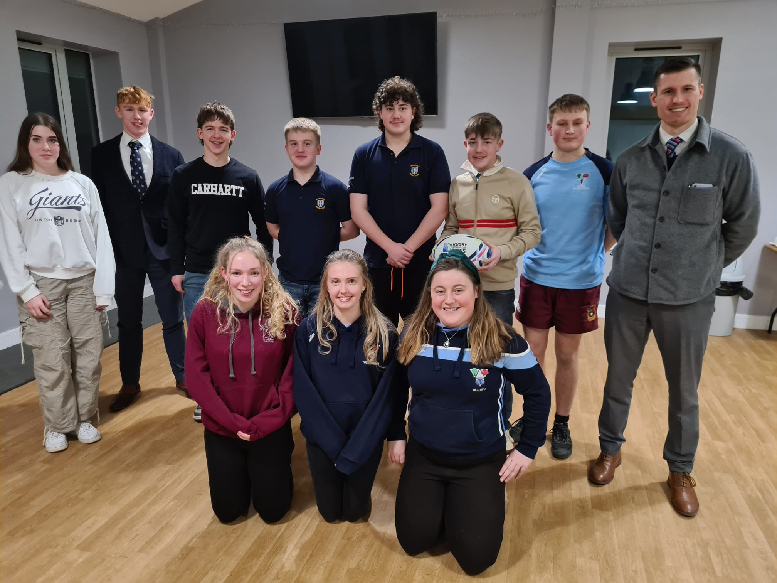
Youth Representative responses

Slide 14
How can your club help with these points?

Slide 15
What we like to see.
What we don’t like
Opportunities.
Teamwork
Supporting new players.
Experienced players and coaches supporting new players.
Inclusivity.
Players, coaches and referees supporting players who may struggle in certain conditions e.g. pausing for asthmatic or even both sides assisting a player during a game.
Teams to support recruitment in schools.
Teams to help after-school recruitment activities.
Friendly training.
Recruitment through community groups
Medical / physio support for ALL injured players (not just seniors).
Mental and physical injury support for pathway back into rugby.
Multiple youth / junior fixtures before senior games.
Seniors turn up early to help juniors.
Social events so all players can get to know each other.
Attention to the importance of player welfare.
Improves player recruitment and retention.
Parent education
Including concussion training.
Assisting young players with
Saturday / Sunday jobs.

Slide 16
What we like to see.
What we don’t like
Opportunities.
Respect
Clapping off injured players.
Leave competition on the pitch.
Not taking anger or frustration off the pitch.
Referees not listening to player concerns.
When a player is concerned about safety on the pitch, the referee should listen to them before things get out of hand.
Clubs prioritising men's & boys’ fixtures over girls’ and women's fixtures.
Favouritism.
Less favouritism to certain players, including coaches’ children.
Young people involved in the decision-making process.
Young representatives to be listened to by coaches and club officials.
Make a greater effort to consider the mental health of players.

Slide 17
What we like to see.
What we don’t like
Opportunities.
Enjoyment
Bad food after matches
e.g. lack of variety and poor-quality hotdogs etc.
Fun training sessions.
Tailored to the needs of players.
Fewer one-sided matches.
No-one really enjoys a one-sided match. Neither team develops and the team that is defeated heavily becomes demotivated.
Coaches who develop their skills.
Making them able to guide and develop ambitious players.
More opportunities for progression.
Representative and DPP coaches to observe club matches during the season
Fewer gaps between matches.
Lack of fixtures (often caused by ow numbers) is demotivating.
Coaches that include the needs of ALL players
Favouritism
Less favouritism to certain players, including coaches’ children.
Listen to young people about what fixtures they would like.
More opportunities for young people to get involved in the running of the club
More coaching and refereeing courses at the club for young people.
More fixtures that motivate teams.
League structure?

Slide 18
What we like to see.
What we don’t like
Opportunities.
Discipline
Support for each player on the pitch
Controlling anger, especially once we leave the pitch.
Referees listening to the concerns of young players.

Slide 19
What we like to see.
What we don’t like
Opportunities.
Sportsmanship
Supporting new players.
Experienced players and coaches supporting new players.
Inclusivity.
Players, coaches and referees supporting players who may struggle in certain conditions e.g. pausing for asthmatic or even both sides assisting a player during a game.
Friendly training.

Slide 20
What could your club or organisation do?
In your groups, please discuss what your organisation can do to in relation to the Forum's observations and ideas.
Record your ideas on the Padlet – linked via this QR Code.
https://lsf.padlet.org/timwilbraham/what-can-clubs-and-organisations-do-to-put-the-needs-of-youn-xqhuti2r9msphuq
Session 1

Slide 21
What could your club or organisation do?
In your groups, please discuss what your organisation can do to in relation to the Forum's observations and ideas.
Record your ideas on the Padlet – linked via this QR Code.
https://lsf.padlet.org/timwilbraham/session-2-what-can-clubs-and-organisations-do-to-put-the-nee-oz784qruug4xq3v2
Session 2

Slide 22
My club's commitment to Youth Rugby and Youth Representation.
Action point one:
Target date:
Action point two:
Target date:
Action point three:
Target date:

Slide 23
Please record three action points on this form.
We will email your comments to you.
https://forms.office.com/e/CVsj5uf85P

Slide 24
Summary
Youth systems are integral to the longevity of clubs.
These youth sections will grow under a One-Club Mentality, where the TREDS values are implemented across the club.
Different clubs face different challenges – set up your own Youth Representation system within your club and find out what affects your youth players.

Slide 25
Questions?

